Slide 1

We Taught Our Computers to Identify Clothes
William Chandra, Spencer Ng, Anthony Nguyen

Slide 2
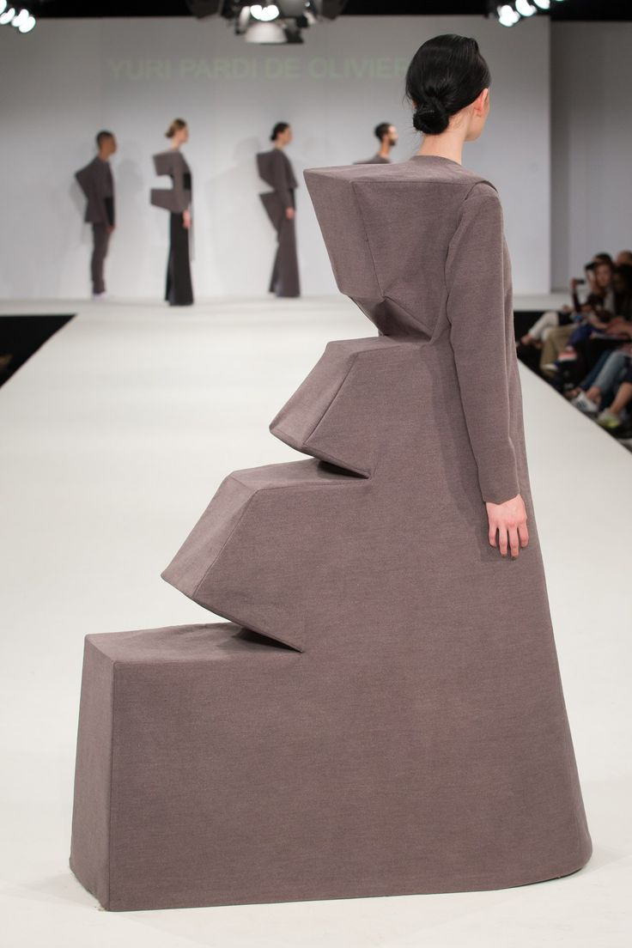
Can Computers Identify Clothing?
We used three CNN models to test it.
Images with color
Images with PCA applied
Images grayscaled using SVD
Tested on increasingly difficult pieces of clothing.
Game at the end!

Slide 3
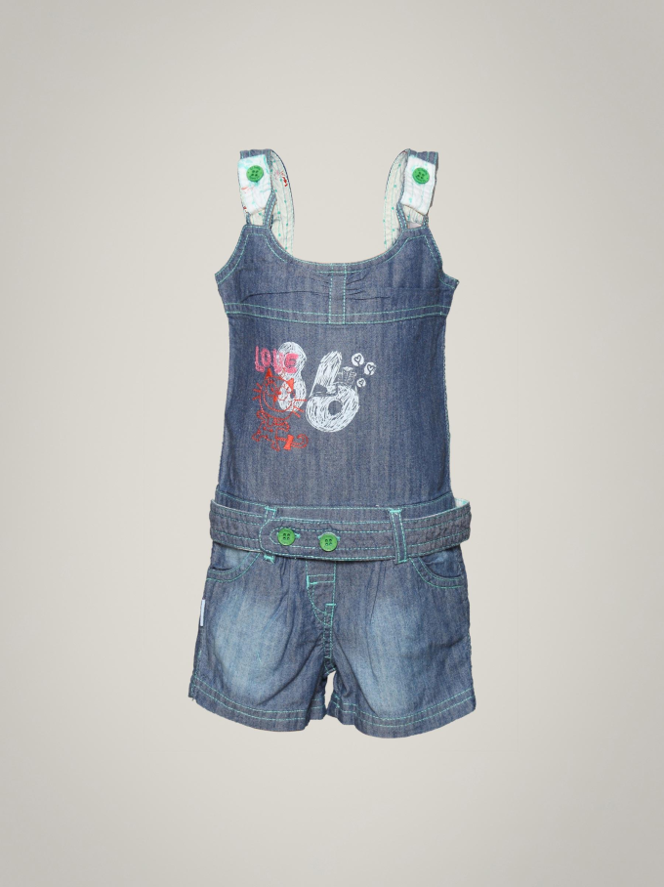
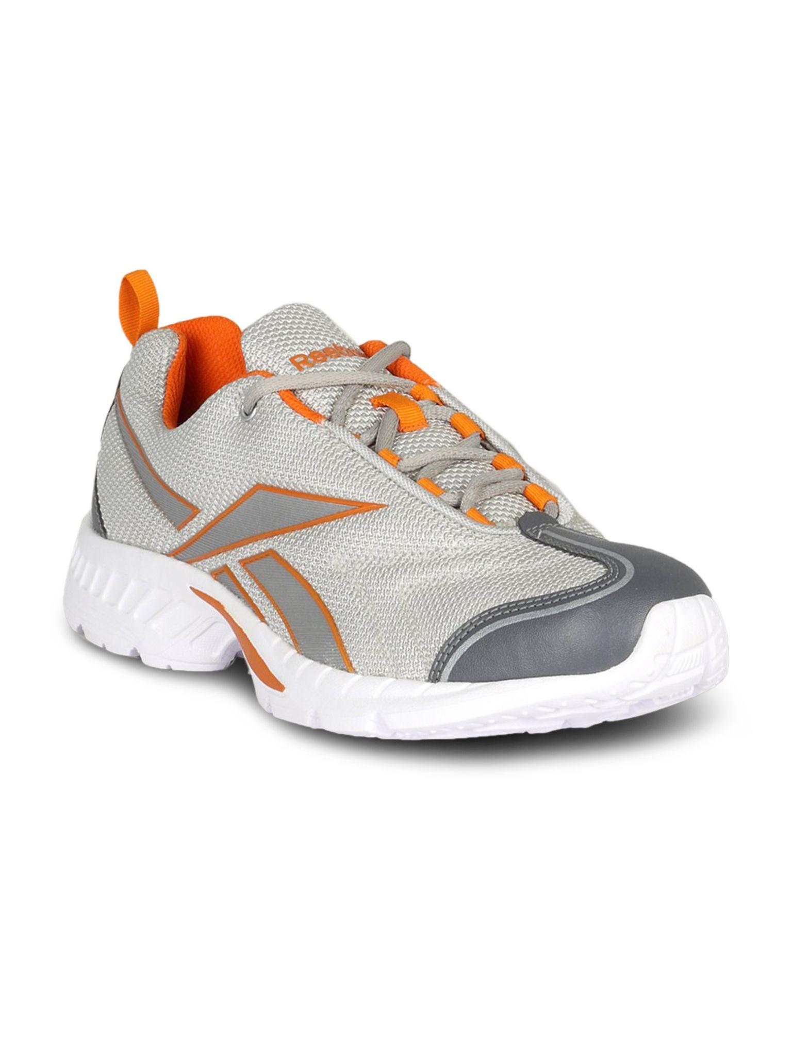
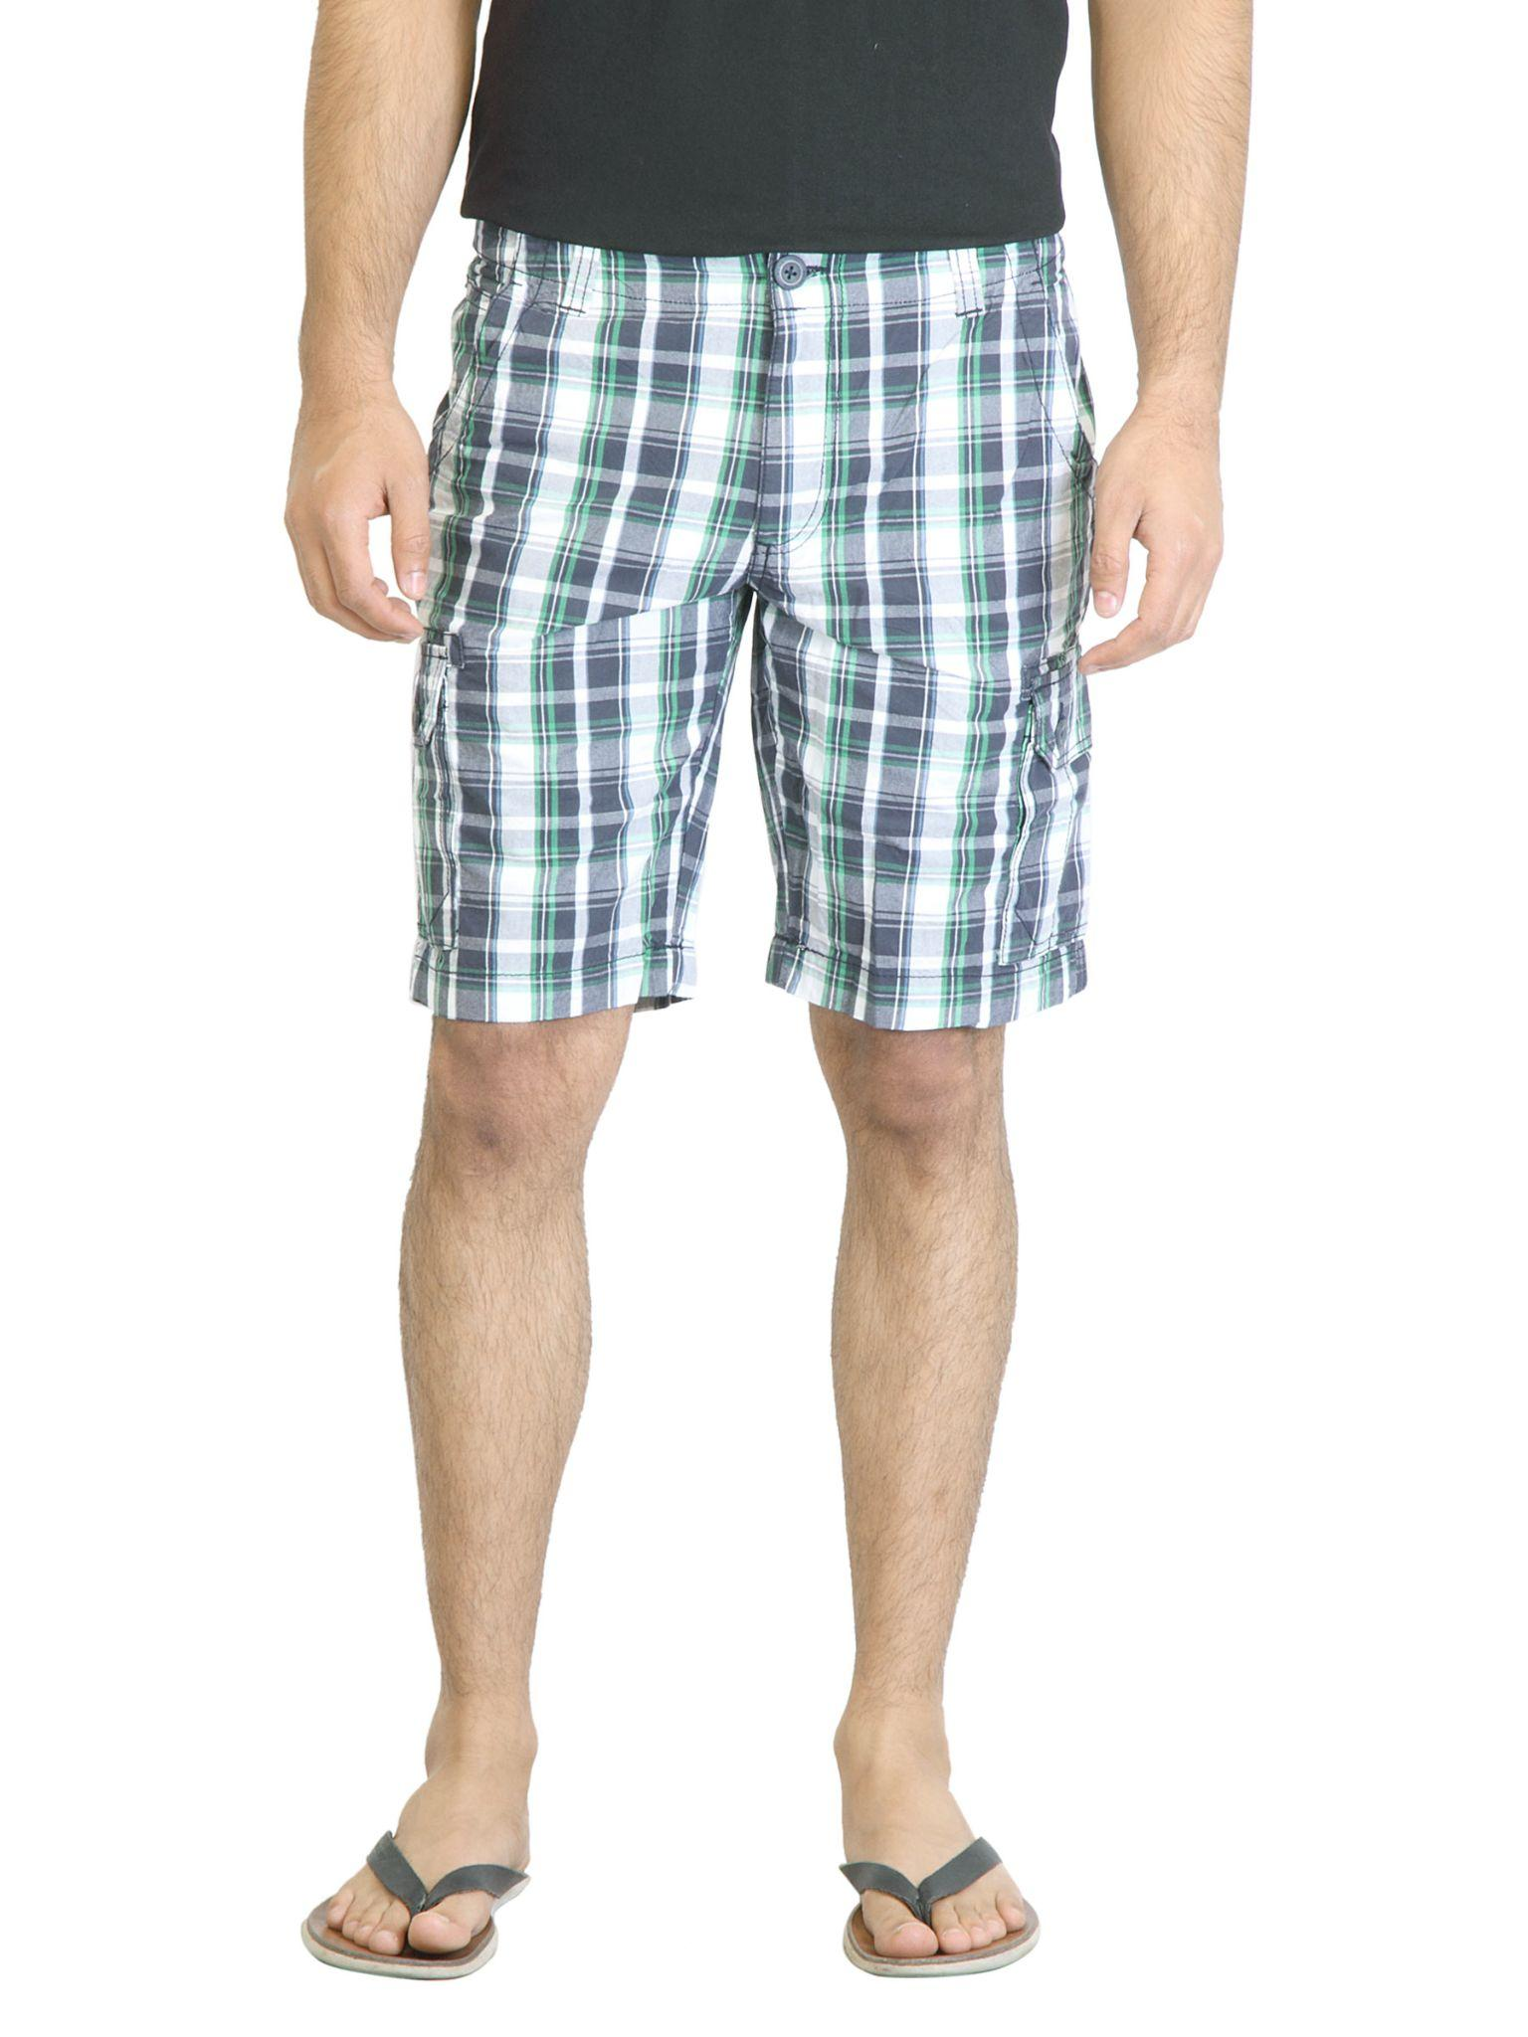
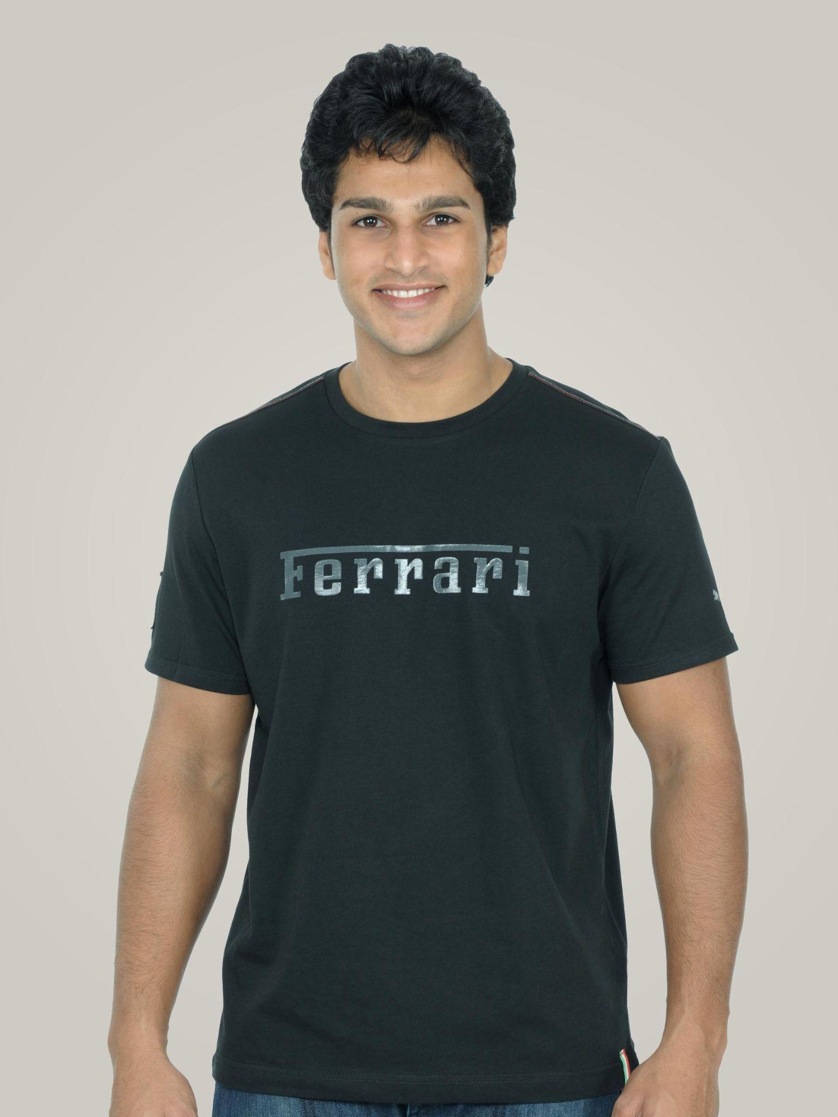
Image Data and Cleaning
143 categories of clothing (20 used)
Grouped into ten different categories
44441 images (1800 x 2400)
Not sorted by category
Random sample of 50 images from each category
Time and Storage Constraints

Slide 4
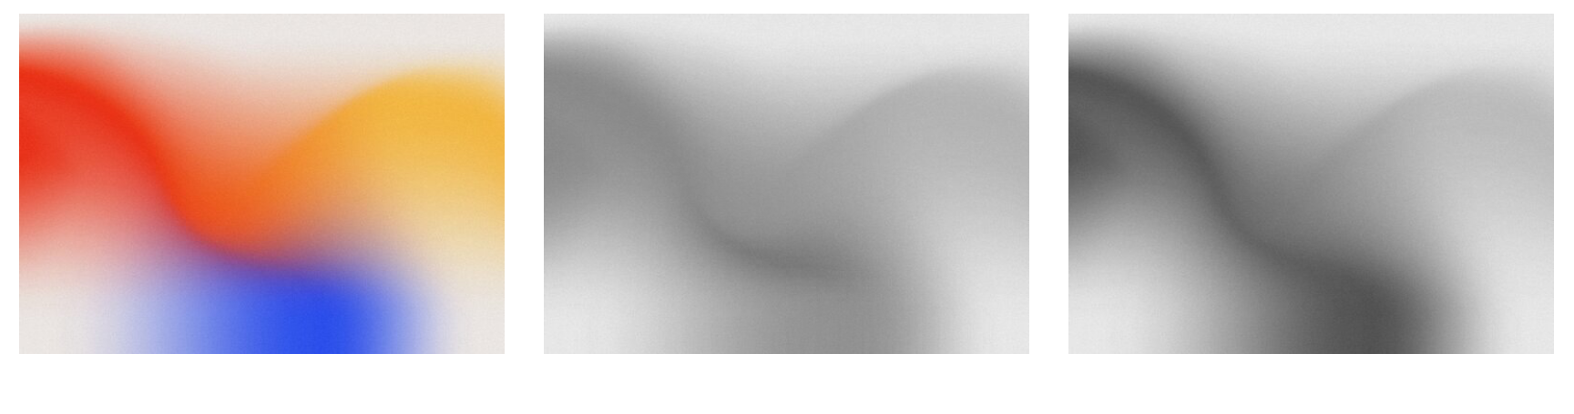
Grayscaling Images
Tested two methods for turning images black and white.
Traditional Method
Singular Value Decomposition
RGB Image
Traditional Method
SVD Method

Slide 5
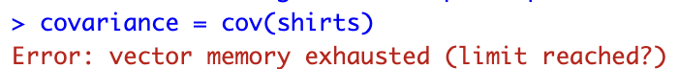
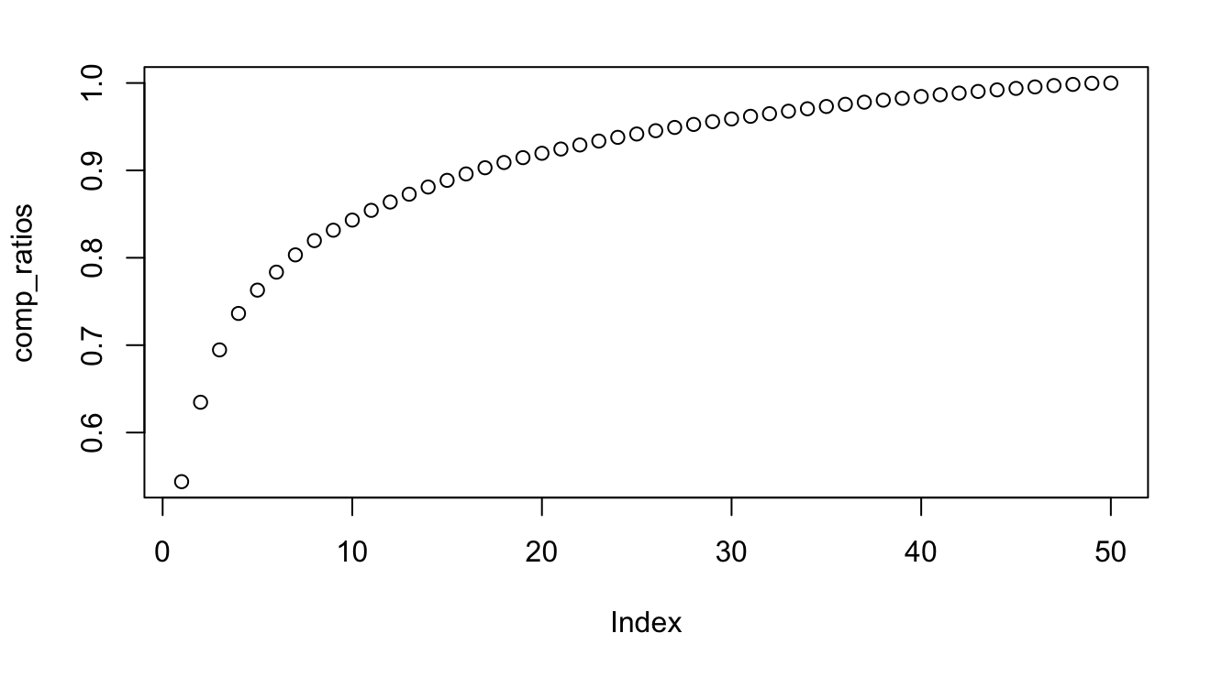
PCA
Covariance matrix - over 70 TB per category!
Used the prcomp library to create the component vectors
Chose components based on variance ratios
Started converging at around six principal components
Used enough components that accounted for 95% of the data

Slide 6
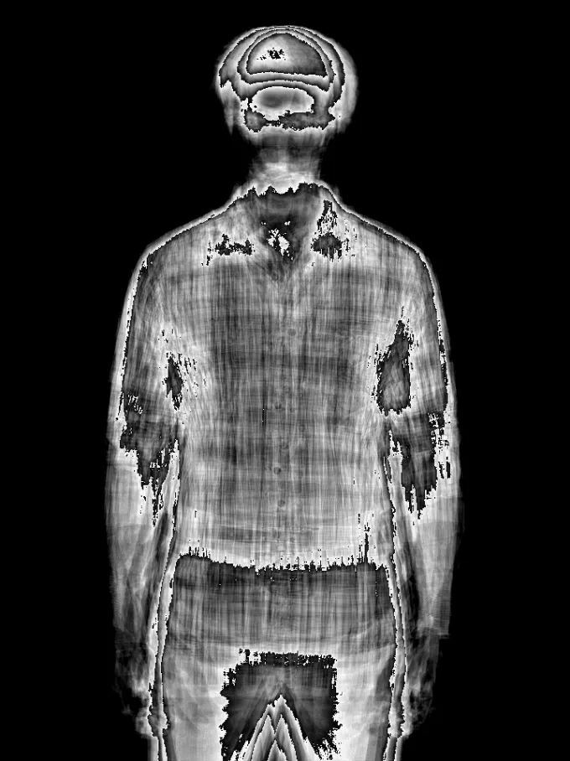
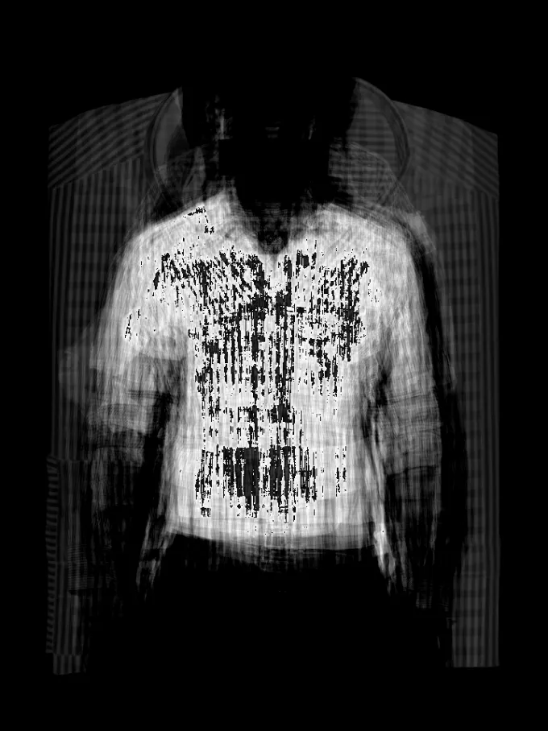
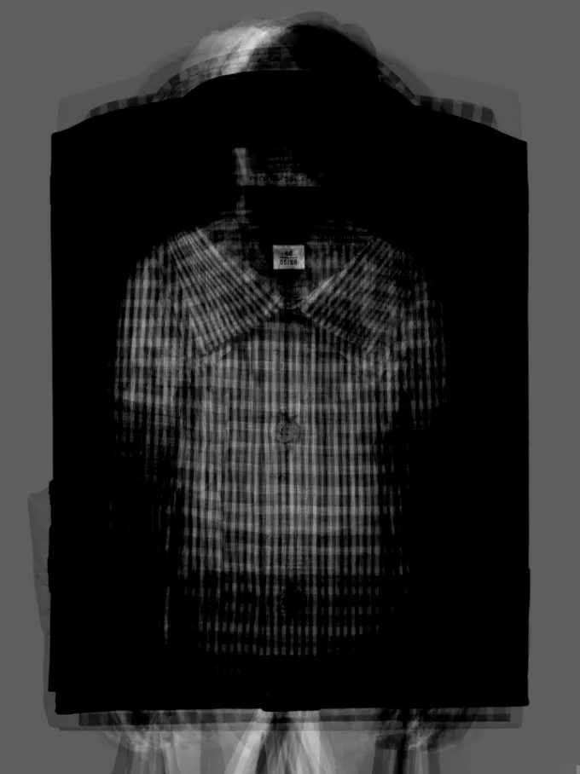
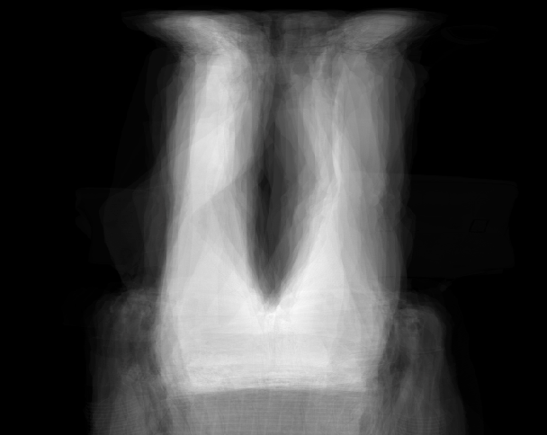
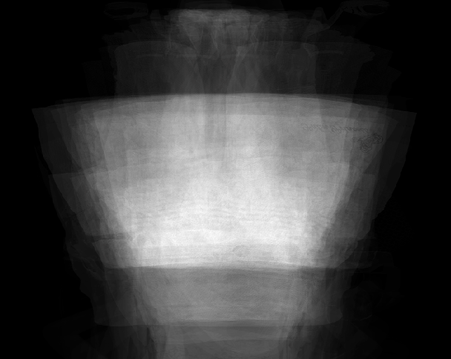
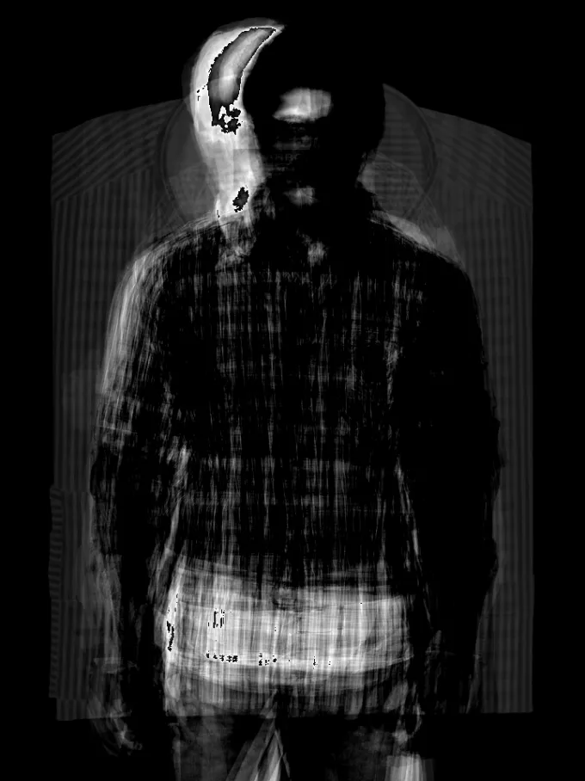
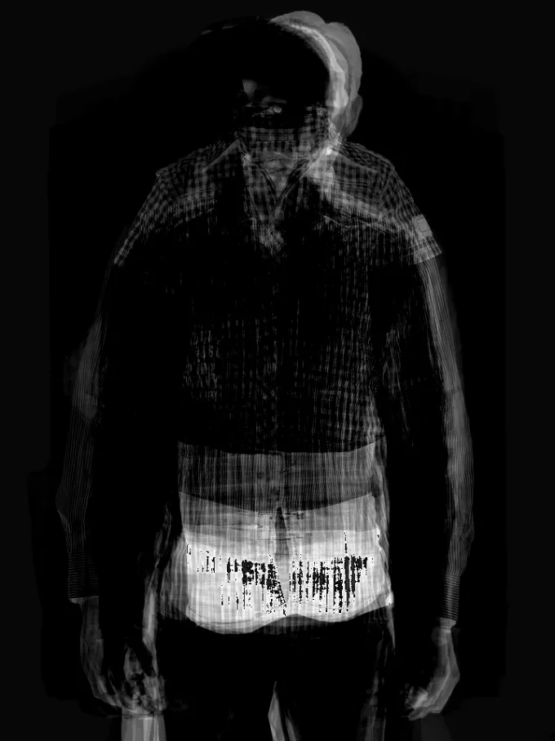
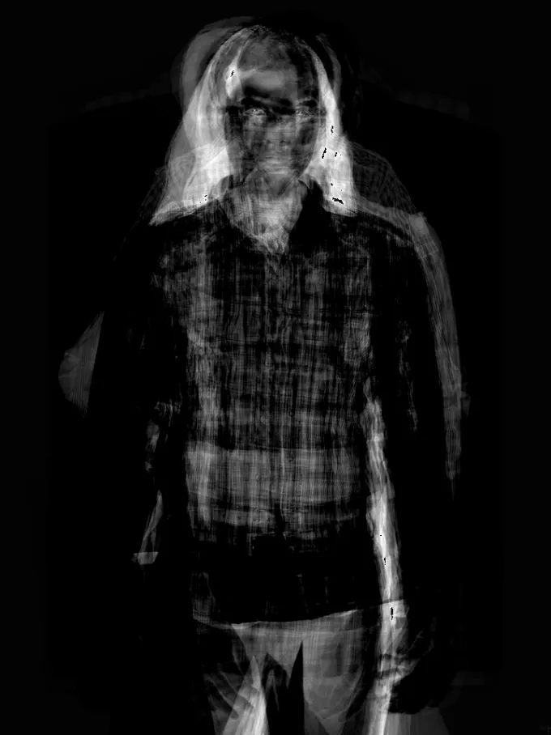
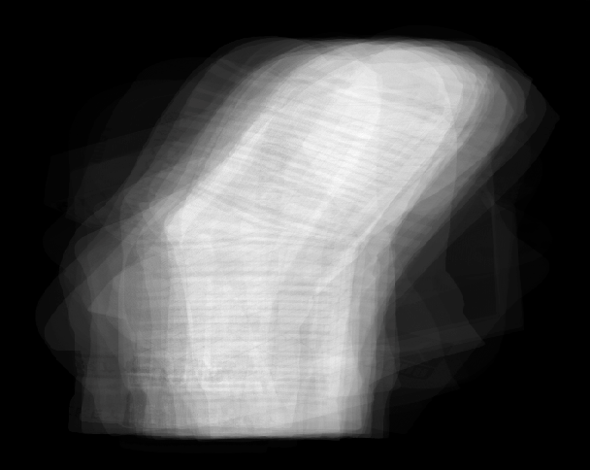
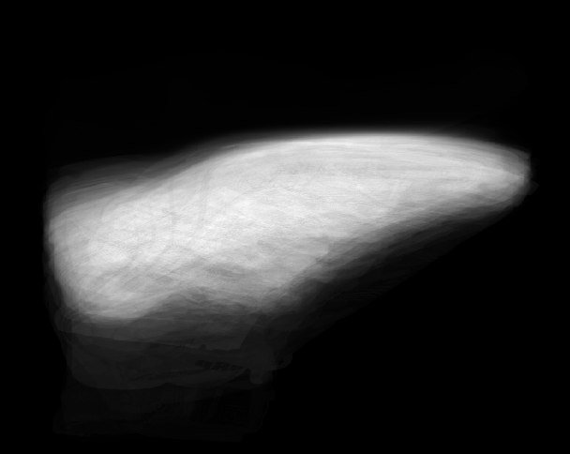
First Six PCAs
First PCAs

Slide 7
CNN
We chose a CNN model to handle our classification
What is a CNN?
We used a tensor flow CNN model
Used ReLu for our activation function
Used dropout to improve model

Slide 8
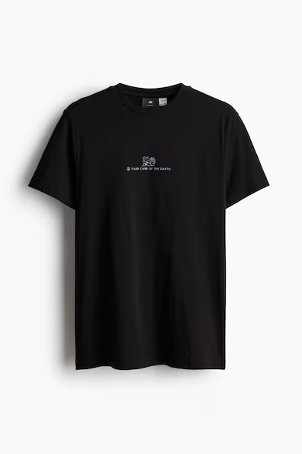
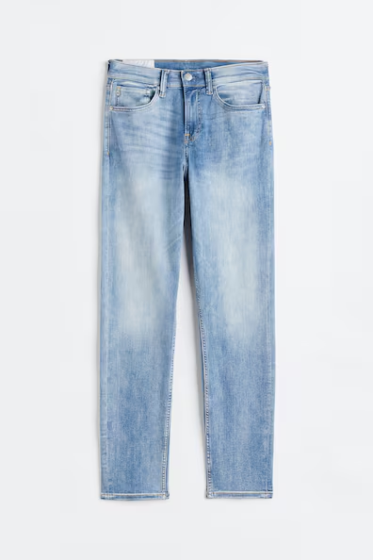
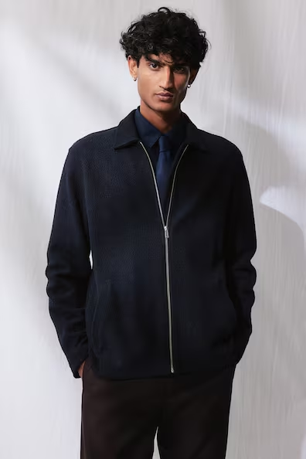

Slide 9
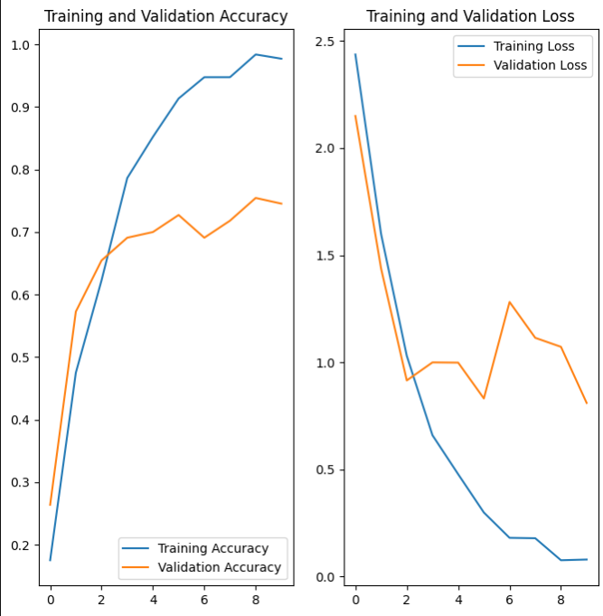
Model Results (Color)
Using images with color results in an okay model.
Thinks the shirt and jacket are formalwear, and that the jeans are a pair of socks.

Slide 10
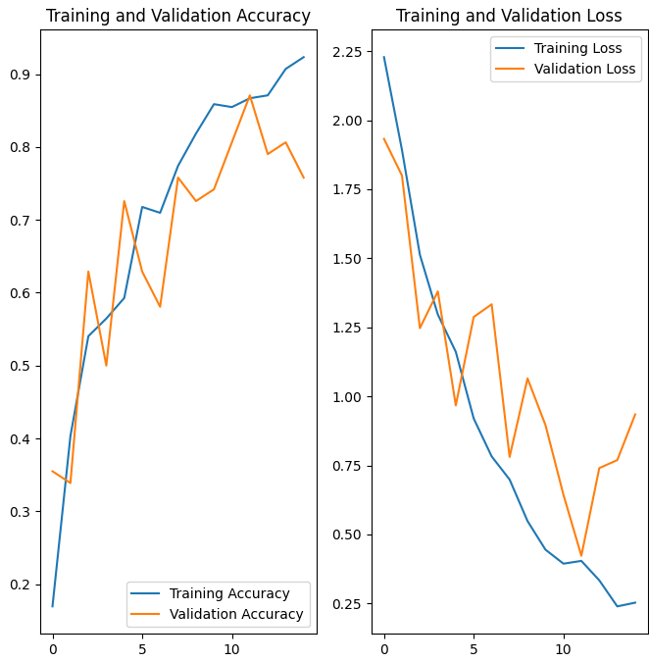
Model Results (PCA)
Using images with PCA applied results in another okay model.
Thinks that the shirt is underwear, and the jeans and jacket are both shirts.

Slide 11
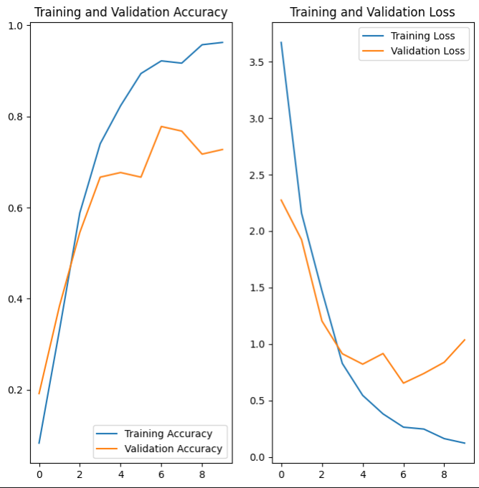
Model Results (SVD Gray)
Using SVD grayscaled images results in the highest accuracy!
Correctly predicts all three test images.

Slide 12
Are you smarter than a CNN Algorithm?

Slide 13
What is this?
Underwear
Dress
Jacket
Skirt

Slide 14
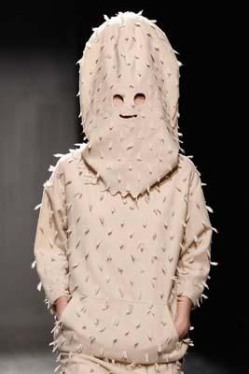
What is this?
Underwear
Dress
Jacket
Shirt

Slide 15
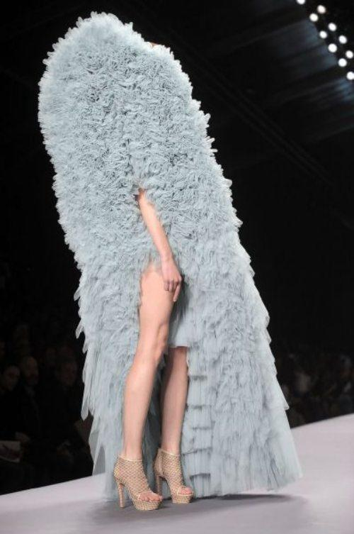
What is this?
Hat
Dress
Jacket
Underwear

Slide 16
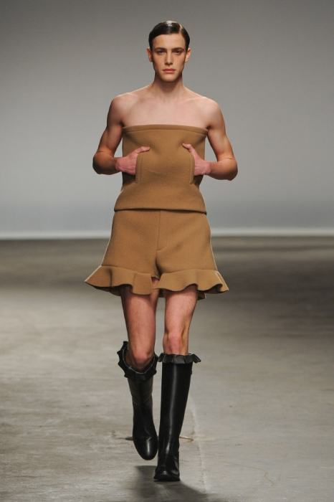
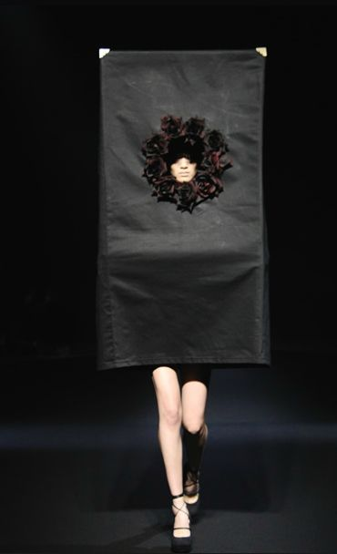
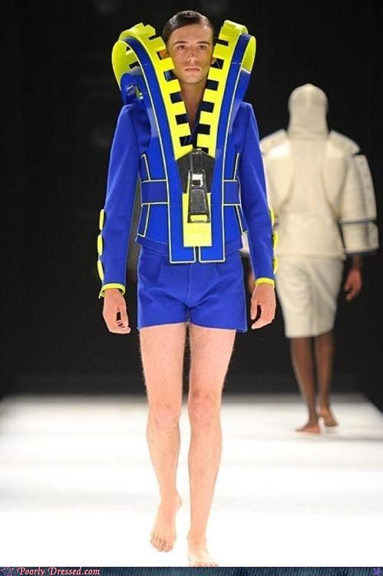

Slide 17
Conclusion
Clothing is harder to predict than you’d think.
What does this mean?
Where do we go from here?

Slide 18
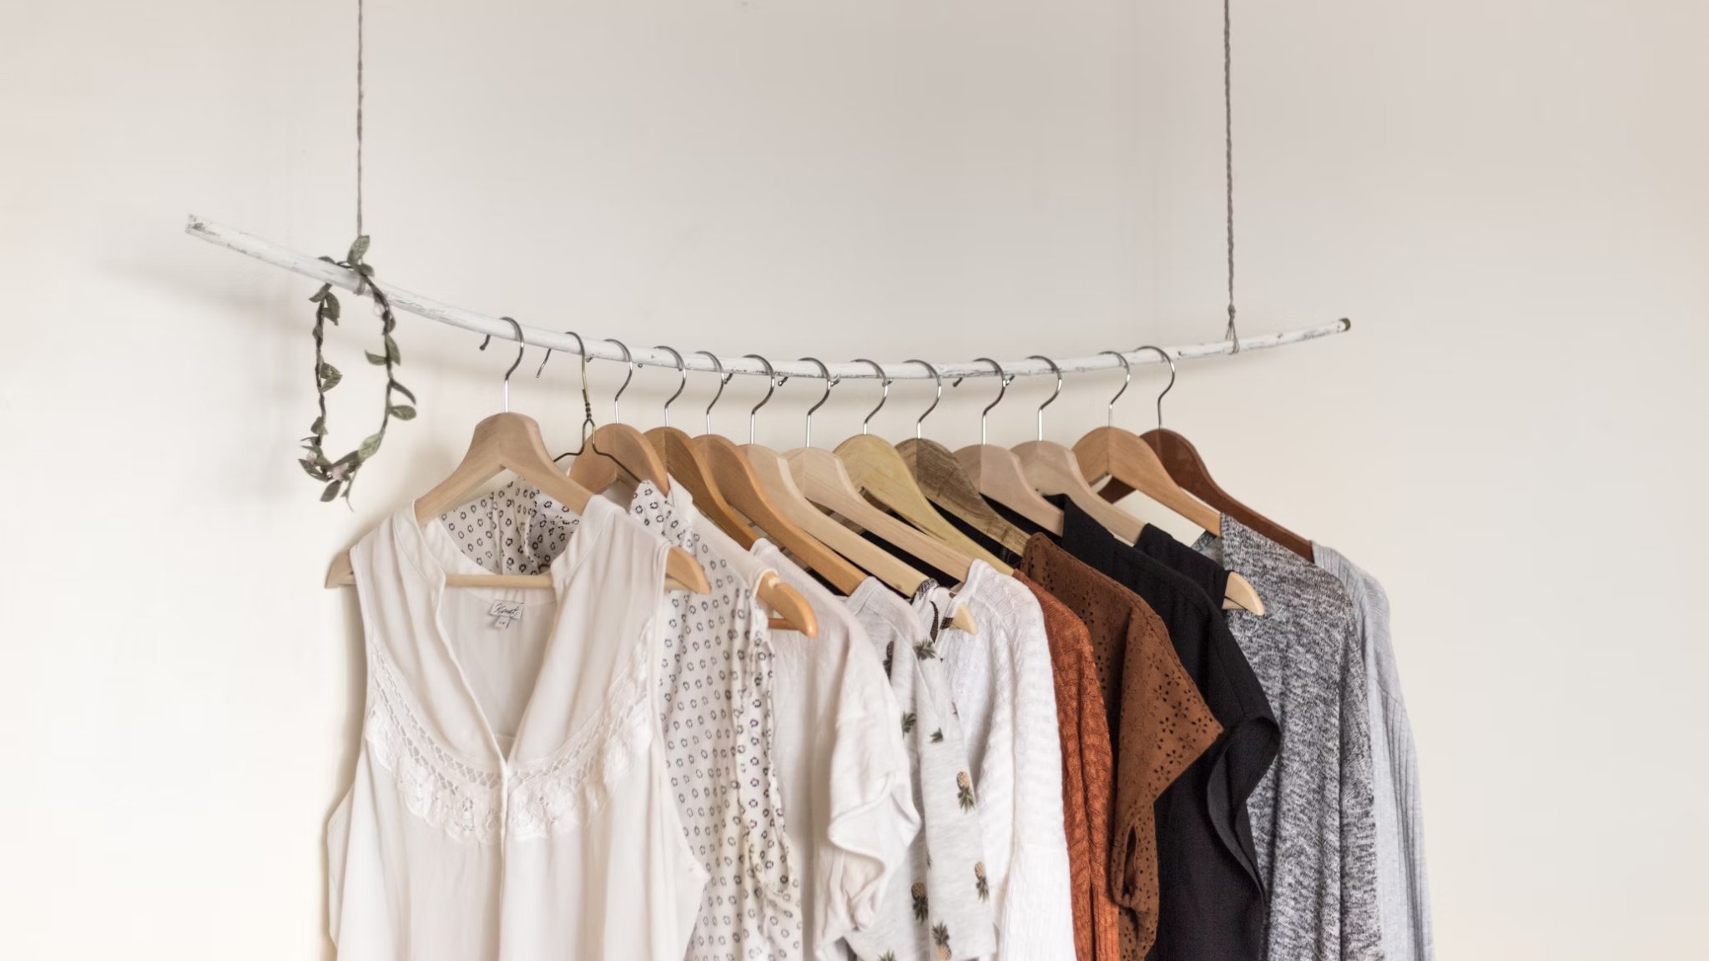
Thank You.

